Slide 1
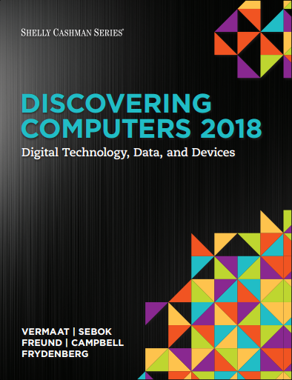

DISCOVERING COMPUTERS 2018 Digital Technology, Data, and Devices
Module 6
Computing Components: Processors, Memory, the Cloud, and More
© 2018 Cengage版權所有，為課本著作之延伸教材，亦受著作權法之規範保護，僅作為授課教學使用，禁止列印、影印、未經授權重製和公開散佈

Slide 2
Objectives Overview (1 of 2)
Describe the various computer and mobile device cases and the contents they protect.
Describe multi-core processors, the components of a processor, and the four steps in a machine cycle.
Identify characteristics of various personal computer processors on the market today, and describe the ways processors are cooled.
Describe what is meant by the Internet of Things.
Explain the advantages and services of cloud computing.

Slide 3
Objectives Overview (2 of 2)
Define a bit, and describe how a series of bits represents data.
Explain how program and application instructions transfer in and out of memory.
Differentiate among the various types of memory.
Describe the purpose of adapter cards and Universal Serial Bus (USB) adapters.
Explain the function of a bus.
Explain the purpose of a power supply and batteries.
Describe how to care for computers and mobile devices.

Slide 4
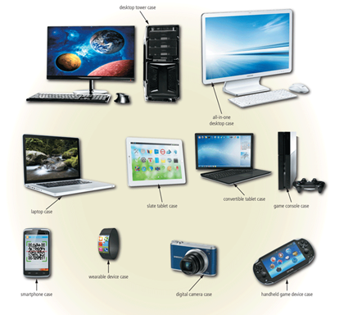
The case contains and protects the electronics of the computer or mobile device from damage
Figure 6-1 Cases for computers and mobile devices are available in a variety of shapes and sizes

Slide 5
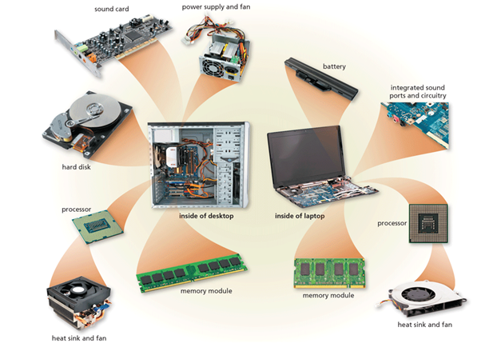
Figure 6-2 This figure shows typical components in a higher-end desktop and laptop. Many basic desktops have integrated video and sound capability, similar to the laptop image shown here.

Slide 6
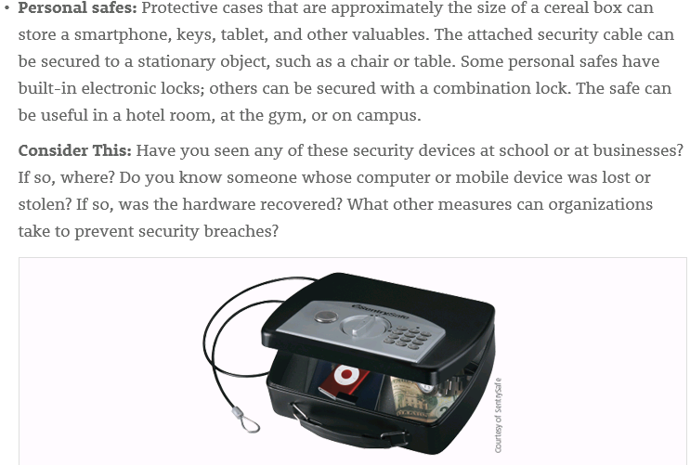

Slide 7
Inside the Case (3 of 4)
The motherboard is the main circuit board of the computer.
A computer chip is a small piece of semiconducting material, usually silicon, on which integrated circuits are etched.

Slide 8
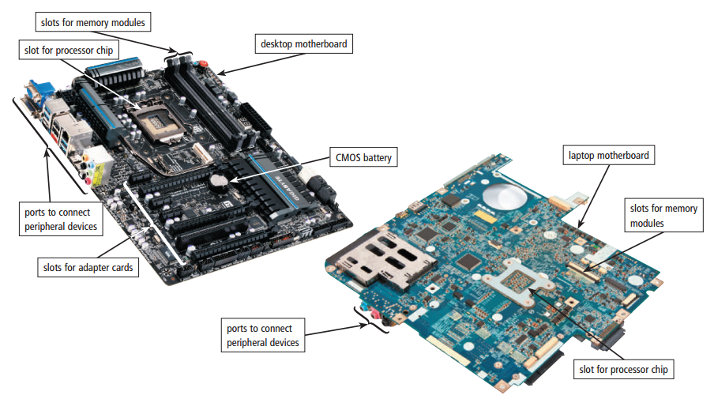
Figure 6-3 A desktop motherboard and a laptop motherboard.

Slide 9
The Processors
Single-core
type
(or)
Multi-core
Processors
Control Unit
component
(and)
Arithmetic logic unit
Processor cooling
Often requirement

Slide 10
Processors (1 of 9)
The processor, also called the Central Processing Unit (CPU), interprets and carries out the basic instructions that operate a computer.
A multi-core processor is a single chip with two or more separate processor cores.
Processors contain a control unit and an Arithmetic Logic Unit (ALU).

Slide 11
The difference between single and multi core processors
 | Single-Core | Multi-core
speed | faster | slower
Performance when users are running muliple programs simultaneously | nope | Performance increase

Slide 12
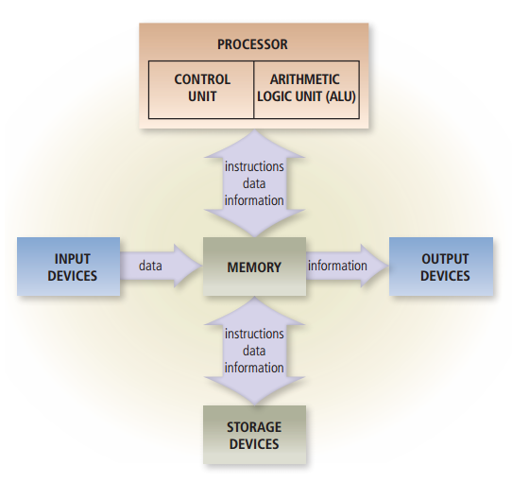
Figure 6-4 Most devices connected to the computer communicate with the processor to carry out a task.

Slide 13
Processors (3 of 9)
The control unit is the component of the processor that directs and coordinates most of the operations in the computer.
The Arithmetic Logic Unit (ALU), another component of the processor, performs arithmetic, comparison, and other operations.

Slide 14
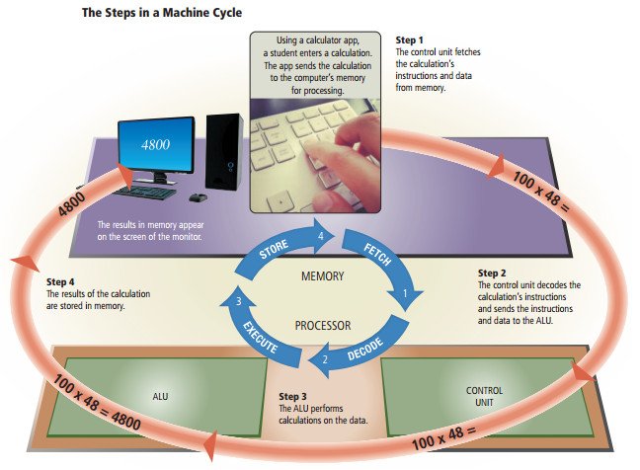
For every instruction, a processor repeats a set of four basic operations, which comprise a machine cycle
Figure 6-5 This figure shows the steps in a machine cycle.

Slide 15
Processors (5 of 9)
The processor contains registers, that temporarily hold data and instructions.
The system clock controls the timing of all computer operations.
The pace of the system clock is called the clock speed, and is usually measured in GigaHertz (GHz).

Slide 16
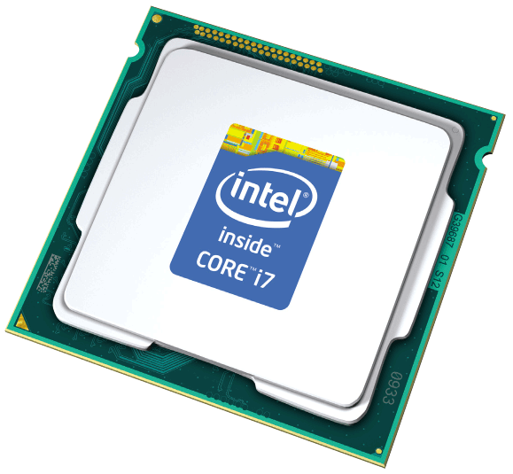
The leading manufacturers of personal computer processor chips are Intel and Advanced Micro Devices (AMD).

Slide 17
Processors (7 of 9)
A processor chip generates heat that could cause the chip to malfunction or fail.
Require additional cooling
Heat sinks
Liquid cooling technology
Cooling pads

Slide 18
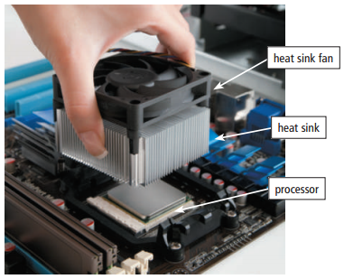
Figure 6-6 This photo shows a heat sink being attached to the top of a processor to prevent the chip from overheating.

Slide 19
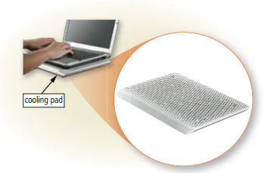
Figure 6-7 A laptop cooling pad helps reduce heat generated by a laptop.

Slide 20
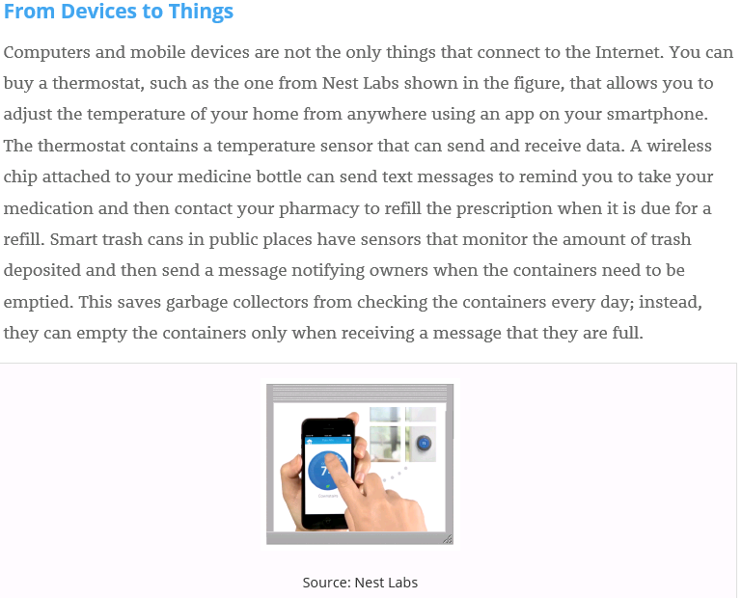

Slide 21
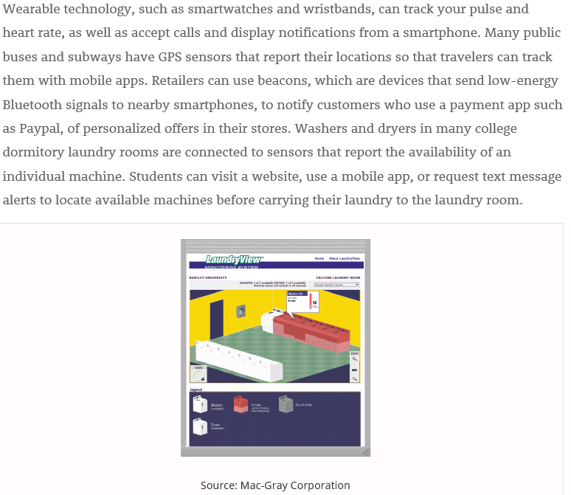
GPS: Global Positioning System

Slide 22
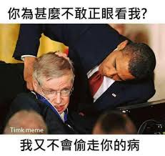

Slide 23

Cloud Computing

Slide 24
Cloud Computing
Home and business users choose cloud computing for a variety of reasons:
Accessibility
Cost savings
Space savings
Scalability

Slide 25
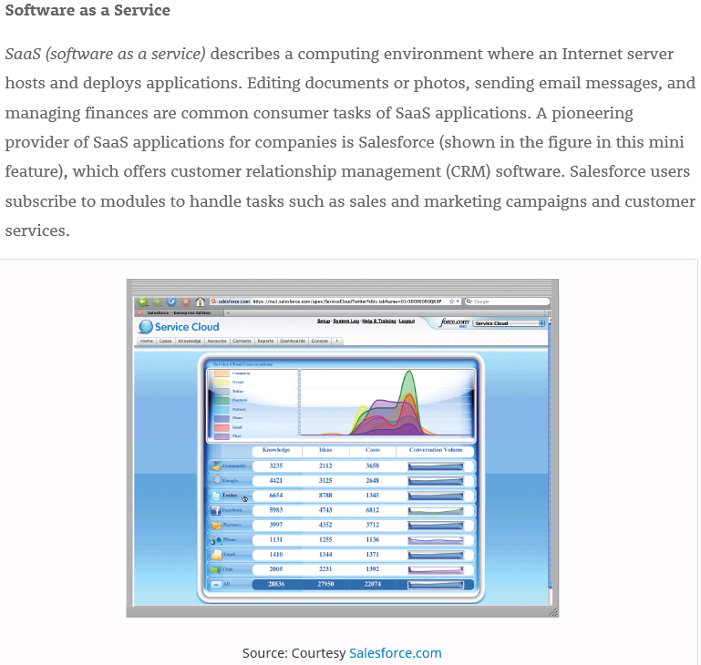
p

Slide 26
Data And Memory
DRAM
volatile
includes
RAM
memory
type
SRAM
Non-volatile
ROM
Flash Memory

Slide 27
Data Representation (1 of 4)
Analog signals are continuous and vary in strength and quality.
Digital signals are in one of two states: on or off
Most computers are digital.
The binary system uses two unique digits (0 and 1).
Bits and bytes

Slide 28
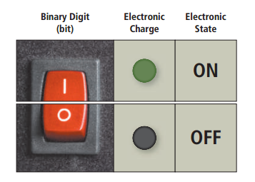
Figure 6-8 The circuitry in a computer or mobile device represents the on or the off states electronically by the presence or absence of an electronic charge.

Slide 29
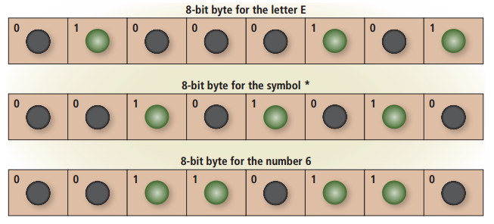
Figure 6-9 Eight bits grouped together as a unit are called a byte. A byte represents a single character in the computer or mobile device.

Slide 30
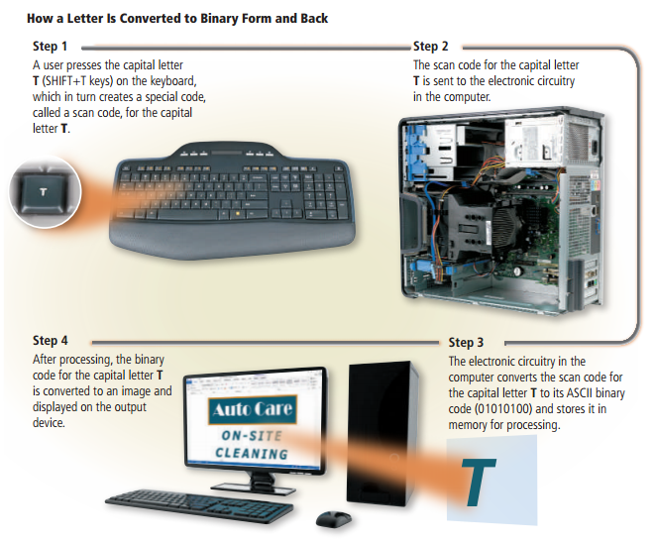
Figure 6-10 This figure shows how a letter is converted to binary form and back.

Slide 31
Memory (1 of 12)
Memory consists of electronic components that store instructions waiting to be executed by the processor, data needed by those instructions, and the results of processing the data.
Stores three basic categories of items:
The operating system and other programs
Applications
Data being processed and the resulting information

Slide 32
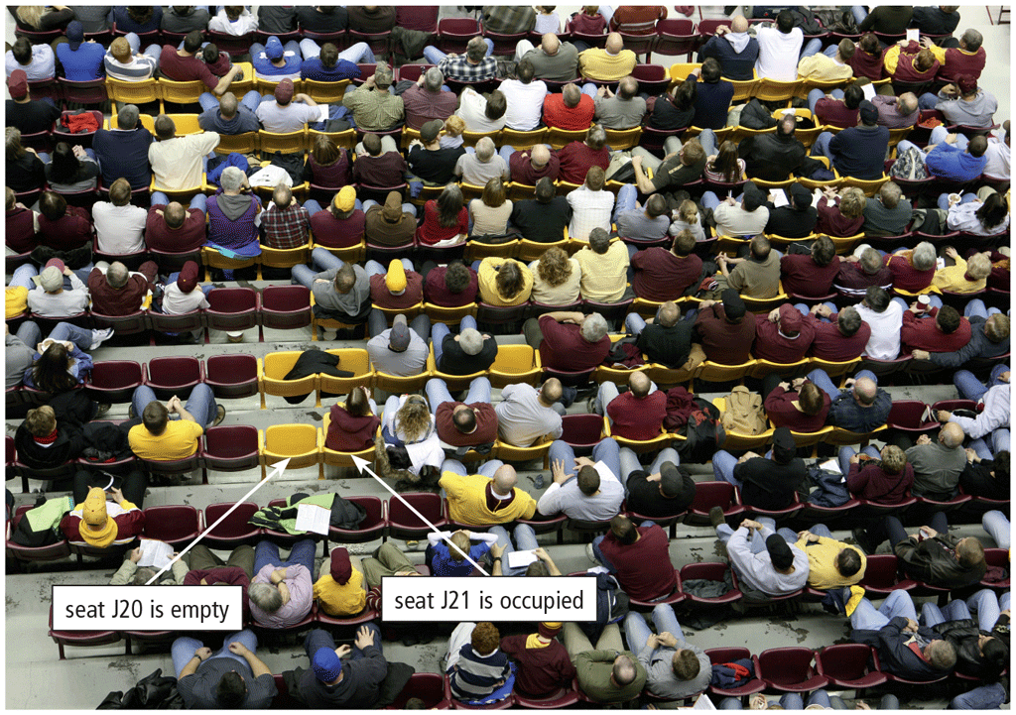
Memory (2 of 12)
Each byte resides temporarily in a location in memory that has an address
Memory size commonly is measured in GigaBytes (GB)

Slide 33
Memory (3 of 12)
Computers and mobile devices contain two types of memory:
Volatile memory
Loses its contents when power is turned off
Example includes RAM
Nonvolatile memory
Does not lose contents when power is removed
Examples include ROM, flash memory, and CMOS
RAM: Random Access Memory
ROM: Read-Only Memory
CMOS: Complementary Metal Oxide Semiconductor

Slide 34
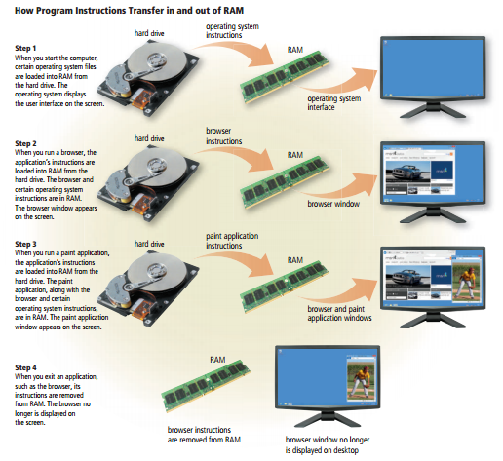
Figure 6-12 This figure shows how program and application instructions transfer in and out of RAM.

Slide 35
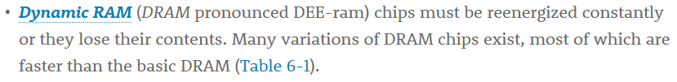
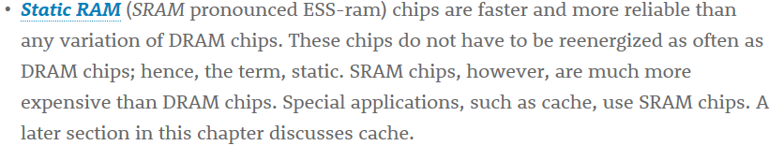
Memory (5 of 12)
Two common types of RAM exist:
Dynamic RAM (DRAM)
Static RAM (SRAM)

Slide 36
Memory (6 of 12)
Table 6-1 common DRAM Variations
Name | Comments
SDRAM (Synchronous DRAM) | Synchronized to the system clock Much faster than DRAM
DDR SDRAM (Double Data Rate SDRAM) | Transfers data twice, instead of once, for each clock cycle Faster than SDRAM
DDR2 | Second generation of DDR Faster than DDR
DDR3 | Third generation of DDR Designed for computers with multi-core processors Faster than DDR2
DDR4 | Fourth generation of DDR Faster than DDR3
RDRAM (Rambus DRAM) | Much faster than SDRAM

Slide 37
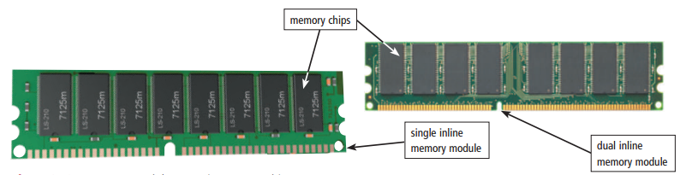
Memory (7 of 12)
RAM chips usually reside on a memory module and are inserted into memory slots.
Figure 6-13 Memory modules contain memory chips.

Slide 38
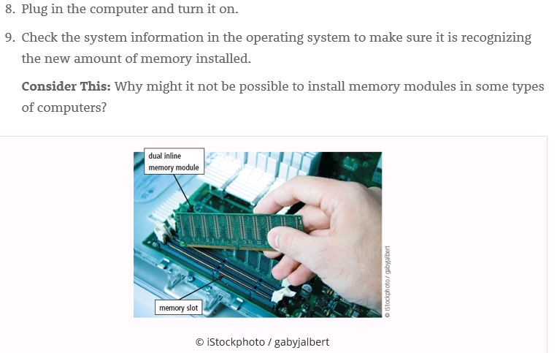

Slide 39
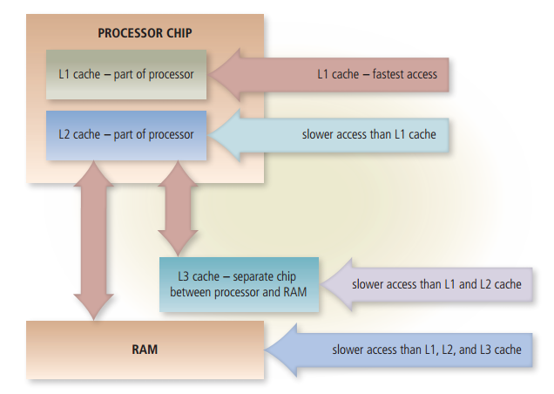
Memory cache speeds the processes of the computer because it stores frequently used instructions and data
Figure 6-14 Memory cache helps speed processing times when the processor requests data, instructions, or information.

Slide 40
Memory (9 of 12)
Read-Only Memory (ROM) refers to memory chips storing permanent data and instructions.
Firmware

Slide 41
Memory (10 of 12)
Flash memory can be erased electronically and rewritten.
Complementary Metal Oxide Semiconductor (CMOS) technology uses battery power to retain information when the power to the computer is off.

Slide 42
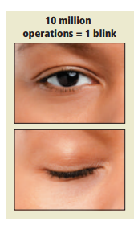
Access time is the amount of time it takes the processor to read from memory
Measured in nanoseconds
Figure 6-15 It takes about one-tenth of a second to blink your eye, in which time a computer can perform some operations 10 million times.

Slide 43
Memory (12 of 12)
Table 6-2 access Time Terminology
Term | Abbreviation | Speed
Millisecond | ms | One-thousandth of a second
Microsecond | µs | One-millionth of a second
Nanosecond | ns | One-billionth of a second
Picosecond | ps | One-trillionth of a second

Slide 44

Joke

Slide 45
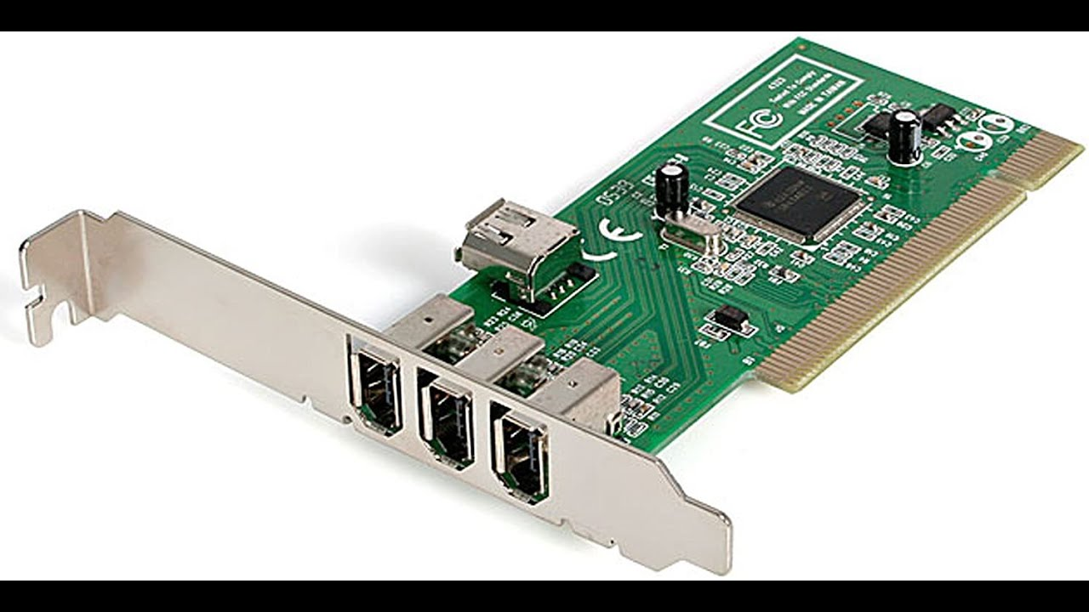
Adapters

Slide 46
Adapters (1 of 4)
An adapter card enhances functions of a component of a desktop or server system unit and/or provides connections to peripheral devices:
Sound card and video card
An expansion slot is a socket on a desktop or server motherboard that can hold an adapter card.

Slide 47
Adapters (2 of 4)
MIDI: Musical Instrument Digital Interface
TV: TeleVision
USB: Universal Serial Bus
Table 6-3 adapter cards
Type | Purpose
Bluetooth | Enables Bluetooth connectivity
MIDI | Connects to musical instruments
Modem | Connects to transmission media, such as cable television lines or phone lines
Network | Provides network connections, such as to an Ethernet port
Sound | Connects to speakers or a microphone
TV tuner | Allows viewing of digital television broadcasts on a monitor
USB | Connects to high-speed USB ports
Video | Provides enhanced graphics capabilities, such as accelerated processing or the ability to connect a second monitor
Video capture | Connects to a digital video camera

Slide 48
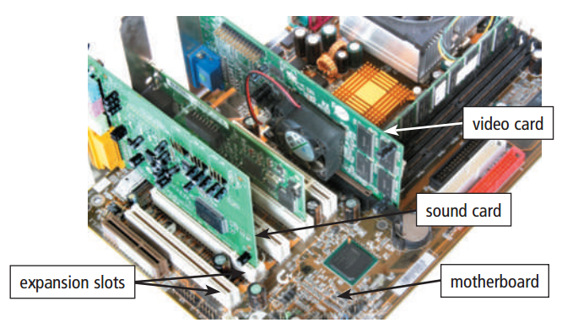
With Plug and Play technology, the computer automatically can recognize peripheral devices as you install them
Figure 6-16 Cards inserted in expansion slots on a desktop motherboard.

Slide 49
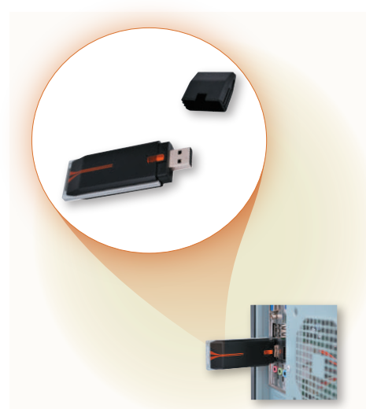
A USB adapter enhances functions of a mobile computer and/or provides connections to peripheral devices.
Figure 6-17 A USB adapter inserts into a USB port on a computer or mobile device.

Slide 50
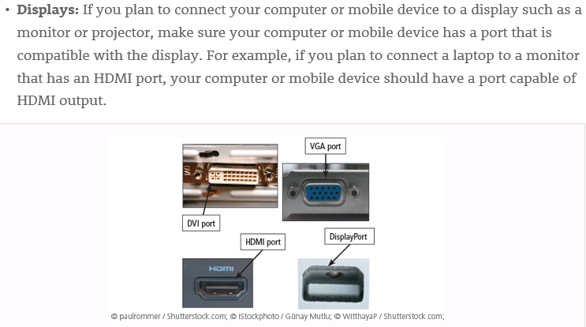
VGA: Video Graphics Array
DVI: Digital Video Interface
HDMI: High-Definition Media Interface

Slide 51
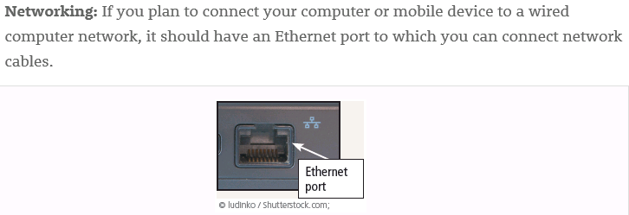

Slide 52
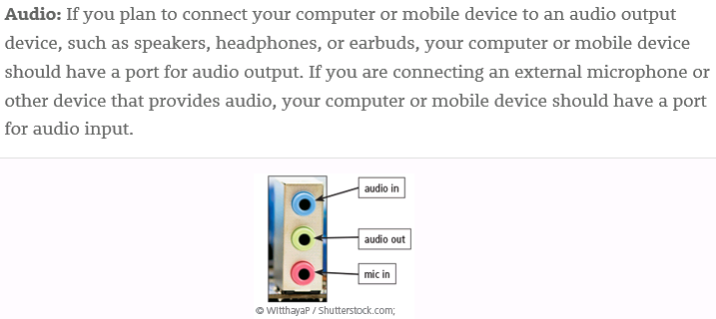
d

Slide 53
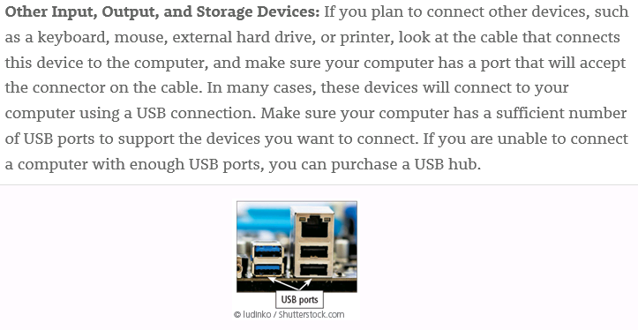
USB: Universal Serial Bus

Slide 54
Buses
System bus
Buses
type
Backside bus
Expansion bus

Slide 55
Buses (1 of 3)
A bus allows the various devices both inside and attached to the system unit to communicate with one another.
Data bus
Address bus
Word size is the number of bits the processor can interpret and execute at a given time.

Slide 56
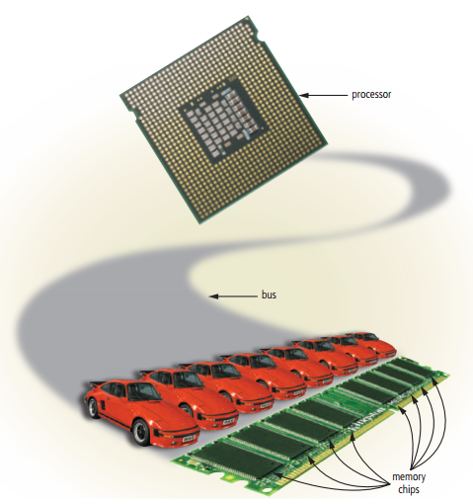
Figure 6-18 Just as vehicles travel on a highway, bits travel on a bus. Buses are used to transfer bits from input devices to memory, from memory to the processor, from the processor to memory, and from memory to output or storage devices.

Slide 57
Buses

Slide 58
Buses (3 of 3)
A computer might have these three types of buses:
System bus
Backside bus
Expansion bus
 | System bus | Backside bus | Expansion bus
Connect | The processor to main memory | The processor to cache
communicate |  |  | Allow The processor to communicate with peripheral devices

Slide 59
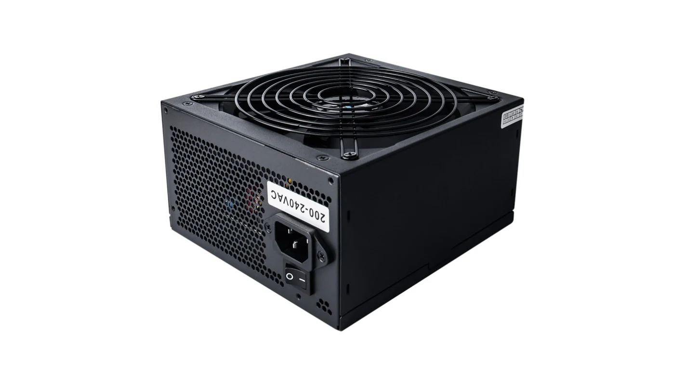
The power supply

Slide 60
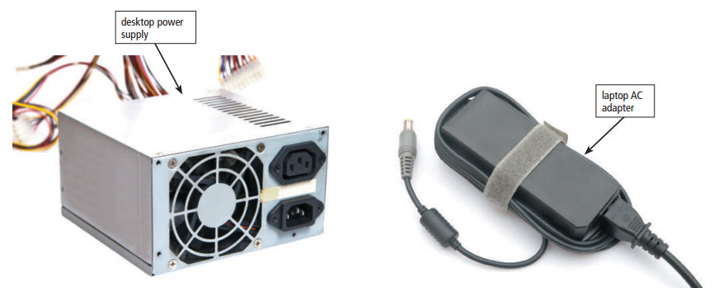
The power supply or laptop AC adapter converts the wall outlet AC power into DC power.
AC: Alternating Current
DC: Direct Current
Figure 6-19 Examples of desktop power supply and laptop AC adapter.

Slide 61
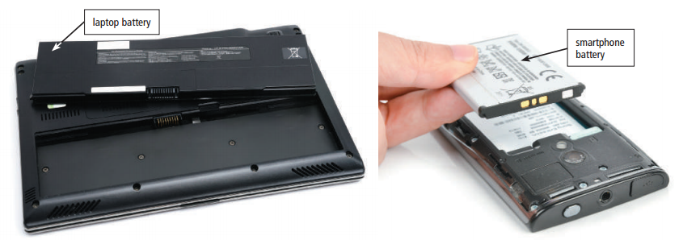
Mobile computers and devices can run using either a power supply or batteries
Batteries typically are rechargeable lithium-ion batteries
Figure 6-20 Rechargeable batteries for mobile computers and devices.

Slide 62
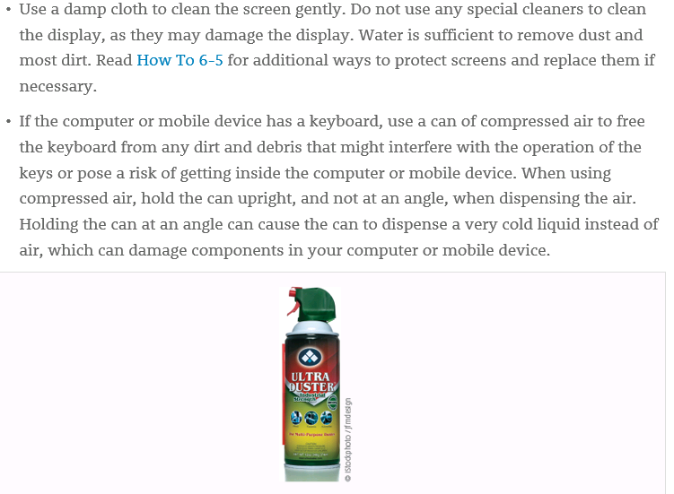

Slide 63
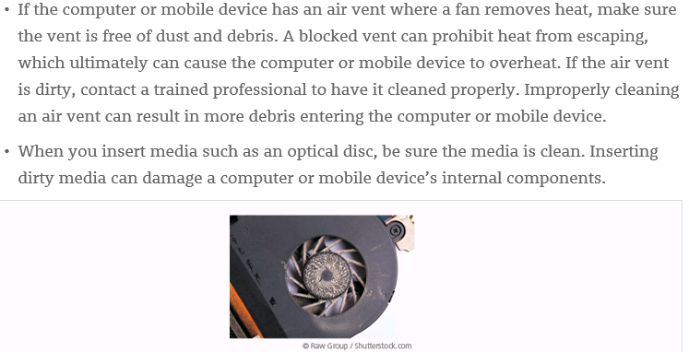

Slide 64
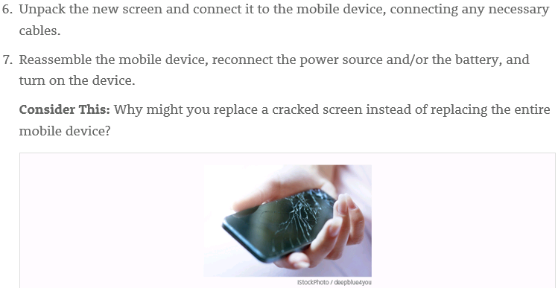

Slide 65
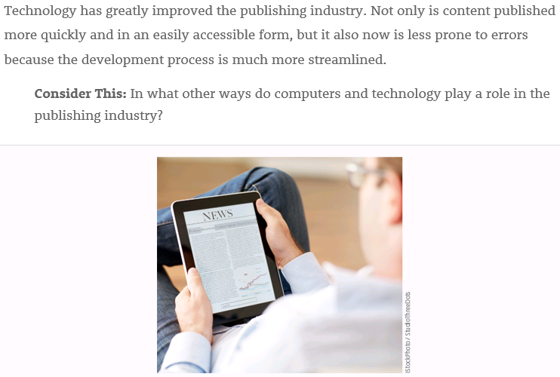

Slide 66
Summary
Various components inside computers and mobile devices
Types of processors, steps in a machine cycle, and processor cooling methods
Advantages and services of cloud computing
How memory stores data and various types of memory
Adapters, buses, power supplies and batteries
Ways to care for computers and mobile devices

Slide 67
Important information(1)
The case contains and protects the electronics of the computer or mobile device from damage
The control unit and The Arithmetic Logic Unit (ALU) are the component of Processors

Slide 68
Important information(2)
The two types of memory are Volatile and Non-volatile
The three types of Buses are System bus, Backside bus and Expansion bus.

Slide 69
Homework
What is the function of the cases
What are the two component of Processors
What is the four step of machine cycle
What is the type of memory
What is the type of Buses

